Slide 1
IST645 - Managing Information System Projects
Final Presentation
Team Members –
Hardik Lilani
Rutwik Ghag
Puneet Shetty Samragyee Pandey

Slide 2

Floyd Furniture AI Integration
Dec 1, 2022

Slide 3
Overview
Proposal: Implementation of Neurala AI visual inspection software at Floyd Furniture to improve quality at scale
Problem Statement:
One of the recent challenges is with including the right quantity of fasteners in the kits - we frequently receive customer complaints about insufficient bolts or special fastening units. This has resulted in decreased customer satisfaction.
There have been a few reports of surface scratches or paint that appears to be subpar. Our staff has determined that the problems were not caused by transportation - they appear to be a result of the manufacturing process, and the inspectors failed to catch them before the parts were transported.
Solution Proposed:
Integration of Neurala AI’s visual inspection software into our salesforce platform for order management and tracking in order to ensure quality during manufacturing
Expected Result:
A smooth integration leading to Floyd being able to fulfill higher volume orders in the future while ensuring quality

Slide 4
Vision and Technological Outcomes
We expect to perfectly integrate Neurala AI’s visual inspection software and take advantage of their L-DNN model’s continuous learning to keep our quality at the highest standard at all times by training it frequently
The inspection process will be automated, and alerts will directly be sent to the managers so that they can respond in a timely manner
The integration will be on our salesforce platform over the cloud, leading to cost reduction for in house servers and a shorter team as QA staff will not be needed
Floyd will be able to fulfill orders with larger volumes than ever before and and at a faster rate
Increase in customer satisfaction leading to an increase in new customers through referrals and WOM; this results in more profits

Slide 5
Process Deliverables
Successful integration of Neurala AI into Floyd Furniture’s manufacturing system
This Presentation
Training new and existing staff to use the system
Direct control over quality accessible to the upper management

Slide 6
Product Deliverables
Increased Customer Satisfaction
Increased Quality of Production for furniture
Ability to fulfill larger orders
Ability to fulfill multiple orders

Slide 7
Scheduling Assumptions and Constraints
Assumptions:
The collaboration between Floyd and Neurala AI will go smoothly
Human resources will be always available
There will be no hardware incompatibility issues while integrating the software
The salesforce platform will integrate smoothly with the software
Constraints:
If stakeholders do not approve of the scope, budget or anything that the team plans to do, there will be a time delay for rectifications
Accounting for all ethnic and religious backgrounds, there are a lot of holidays in October and November
If any parts are damaged during the process, additional costs will exceed the budget
Employees/team members being sick, flu season, COVID-19 during the last quarter of the year and 1st quarter of next year.
Economies of scale impacted by winter weather during the last quarter of the year and 1st quarter of next year.
All materials are provided by vendor and Neural teams in a timely manner.
In six months, Floyd would need to deliver 5000 units to Wayfair and thus the AI inspection should be completed by then.

Slide 8
Project Stages
A. Project Initiation:
Project Management Team sets up introductory meeting with Executives from Neurala to decide the requirements, risks, scope, budget, constraints and design the WBS for the project on 9/13/22
B. Planning & Design:
Project Management Team at Floyd coordinates with Josh Oswald , Floyd’s Business Operations Manager and Salesforce Technical Account Manager Aurelia Johnson who is the Product Integration Advisor. Regular meetings with the stakeholders shall be held for understanding the key requirements of the project process and rectifications. (9/21/22)
After the analysis of all the Business, technical and estimates requirement and major processes involved like budgeting, scope, employee training, report integration into CRM System, software installation, the project shall be sent towards its second step of execution stage. (10/06/22)
Each stage shall be monitored by the Project Team right from the inspection of furniture to the manufacturing of the product till the end of all the steps in manufacturing processes.
C. Execution:
The project shall come into force as soon as the additional contract with Salesforce is executed legally.

Slide 9
During the process of ongoing project, regular meetings and weekly updates shall be sent to the stakeholders including manufacturing and development of the project. (12/9/22)
Regular checks for the AI shall be monitored by the Project Manager and integration of the software and hardware part before any further execution shall be monitored by Aurelia Johnson.(12/16/22)
D. MONITOR & CONTROL
Decided timeline shall be adhered to by the project team and progress shall be monitored on a daily and weekly basis. Regular reports shall be sent to all the stakeholders on weekly basis. (12/26/22)
Any issues regarding the system shall be resolved by Nithin Vajendla who is the Systems Developer in the project.
Any changes shall be brought to the Project Manager and shall be implemented on the approval of Aurelia Johnson and Josh Oswald.
E. CLOSURE
All the process checks, quality checks, number of products and completion of successful trial run of the project agreed to be delivered by Floyd Furniture to Wayfair, are completed, supervised and approved by the Project Manager, Project Integration Advisor, Business (1/9/23)
Operations Manager and VP of Floyd along with all the legal formalities, the project shall be closed on the date agreed upon.

Slide 10
Quality Planning, Assurance and Control Approaches
Stakeholders shall be weekly informed regarding the demonstration run as well as the main production of the software. Feedbacks shall be collected from them and implemented under the supervision of Rachel Brown and Aurelia Johnson.
Quality Audits of the software and hardware shall be reported on a weekly basis to the Project Manager.
Integration, User Acceptance & Performance Training shall be regularly done on a weekly and monthly basis to check the integration of hardware and software under the supervision of Project Manager.
Reliability and Maintainability of the software and hardware shall be tested using simulation models and shall be regularly updated to the stakeholders.

Slide 11
User Acceptance Testing shall be regularly done on a weekly and monthly basis to check and help the team decide of the product is by all means ready to be released to the stakeholders and then subsequently into the market and that the overall system’s quality, the performance of the software integration, shall be done under the supervision of Project Manager.
Alpha and Beta testing shall be implemented during the trial release of the software to check with a few number of users whether the software is runnable and works well before it is released to the stakeholders and subsequently into the market.
Six Sigma Quality analysis and audits shall be mandatorily done wherein few of the many steps involved would be quality control charts, assignment of responsibilities to all the team members, measure the metrics for all the parameters involved and perform a root cause analysis of all the defects if any if they may arrive and report on a weekly basis to the Project Manager.
Reliability and Maintainability of the software and hardware shall be tested using simulation models and shall be regularly updated to the stakeholders.

Slide 12
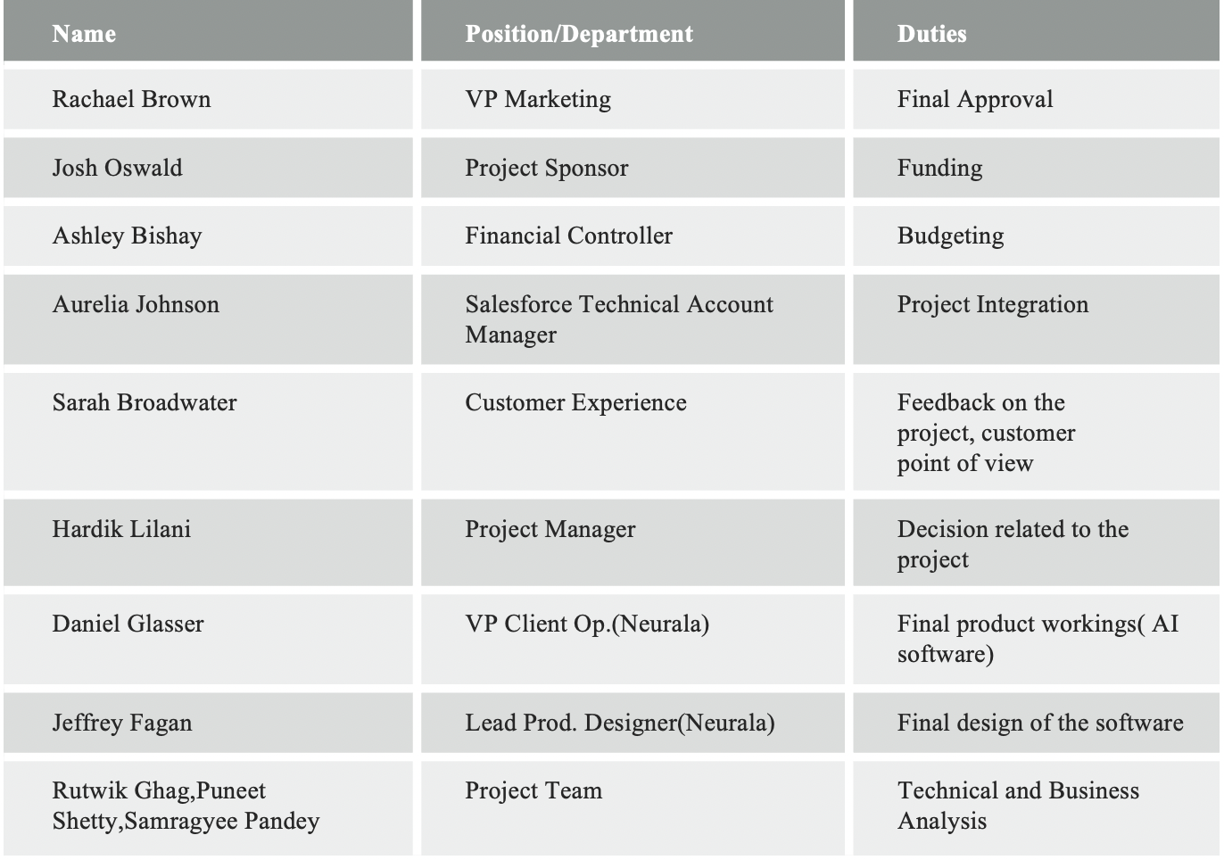
Executive Involvement

Slide 13
Expectations from Executives
Rachel Brown-VP Marketing,Final approval on the project and budgeting.
Josh Oswald-Project sponsor, budgeting and deadlines for the projects
Ashley Bishay- Financial Controller, prepare a budget and manage cost of resources
Aurelia Jhonson- Salesforce Product Integration advisor, Take care of integration support and testing.
Daniel Glasser-VP of client operations(Neurala), communicate downtime and maintain streamlined flow of data.

Slide 14
Thank You!

